Slide 1
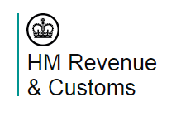
MTD Sandbox Team
Sandbox improvement programme
Jeremy Tomlin
21.06.2023

Slide 2
2022 User research findings
The scenarios available are not comprehensive enough.
In a stateless test environment, sample data simulating the live product does not respond to changing conditions.
The dates used by the endpoints do not reflect realistic parameters of tax years and obligation periods.
The tax year in the Sandbox is outdated and cannot be changed
The date ranges used for sample data are inconsistent between different endpoints.
The stateless environment does not allow vendors to replicate Production accurately, preventing comprehensive testing and debugging
Limited, inconsistent and unrealistic test scenarios and canned data further decrease testing capability

Slide 3
Components we are building
Making endpoints Dynamic
Making endpoints Stateful
Adding new Gov Test Scenarios
Better error handling
New Test API
 | Sandbox environment
API's | 18
Endpoints | 164
Stateful | 150
Dynamic | 28
New error Handling | 18
New Gov Test Scenario | 6
Test API scenario | 5

Slide 4
Test API
Step 1
Enabling ‘simple’ deletion
Step 2 (under investigation)
Complex Deletion
Create a demo world
Giving HMRC unusual data (Company details)
Mockup of the backend in some scenarios

Slide 5
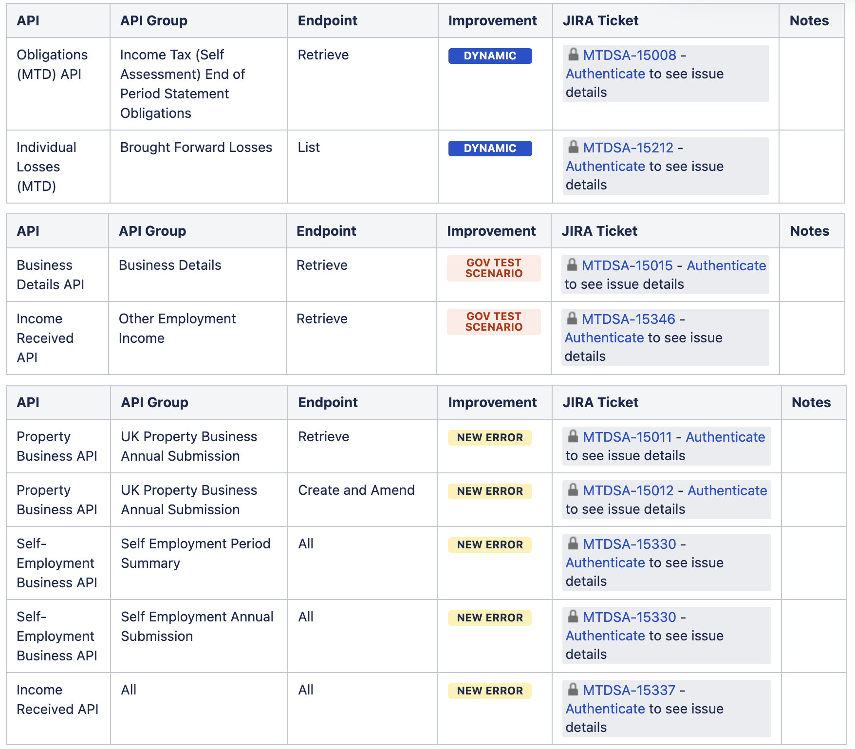
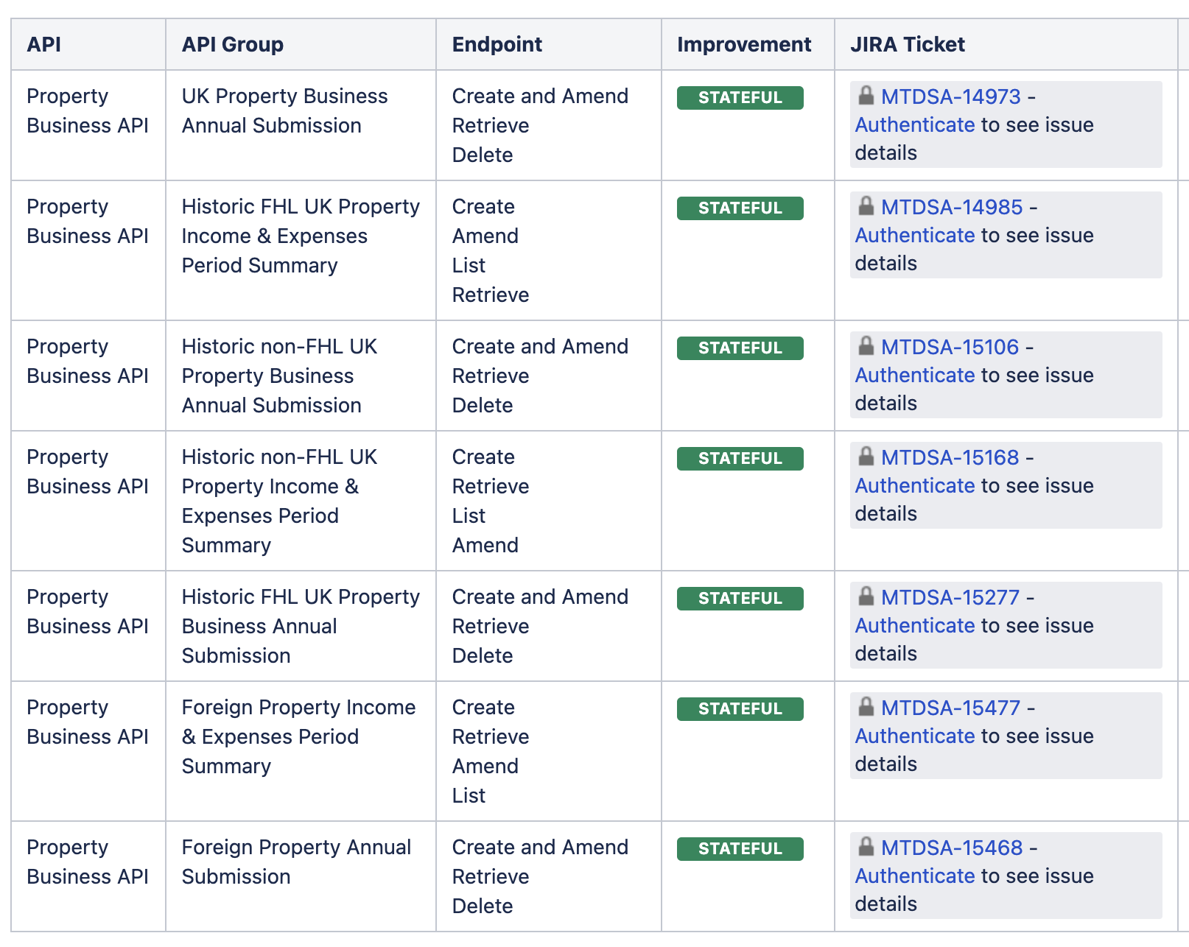
Release 1

Slide 6

Dynamic

Slide 7
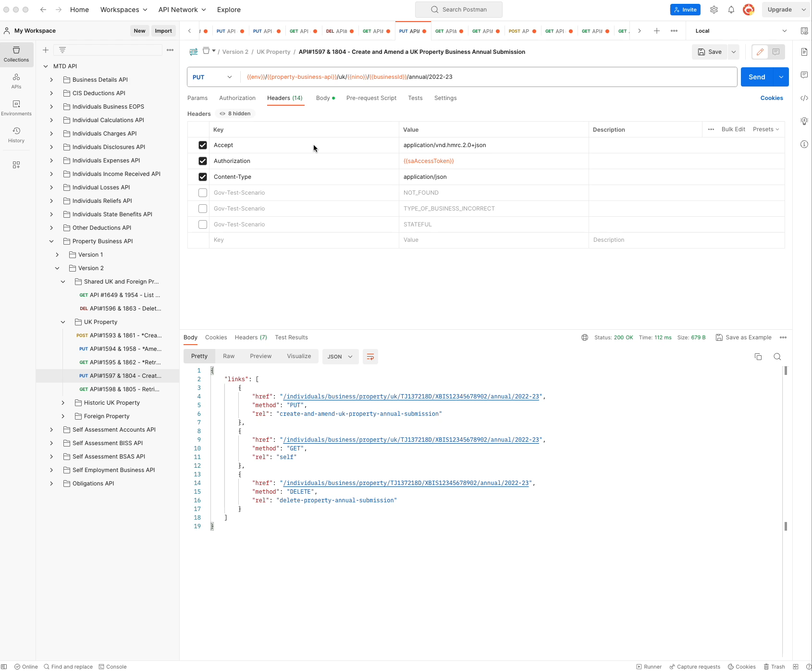
Stateful

Slide 8
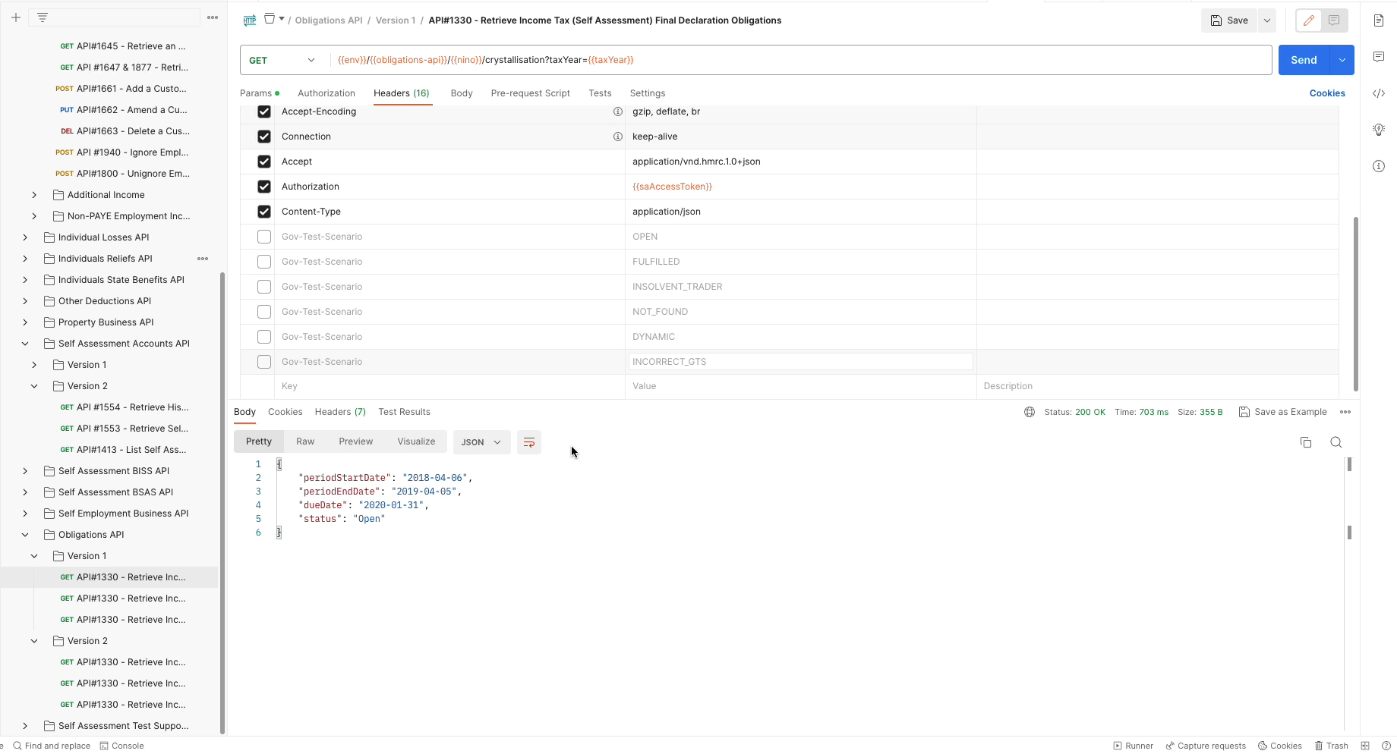
Error handling

Slide 9
Where we have reached
 | Sandbox environment
API's | 18
Endpoints | 164
Stateful | 150
Dynamic | 28
New error Handling | 18
New Gov Test Scenario | 6
Test API scenario | 5

Slide 10
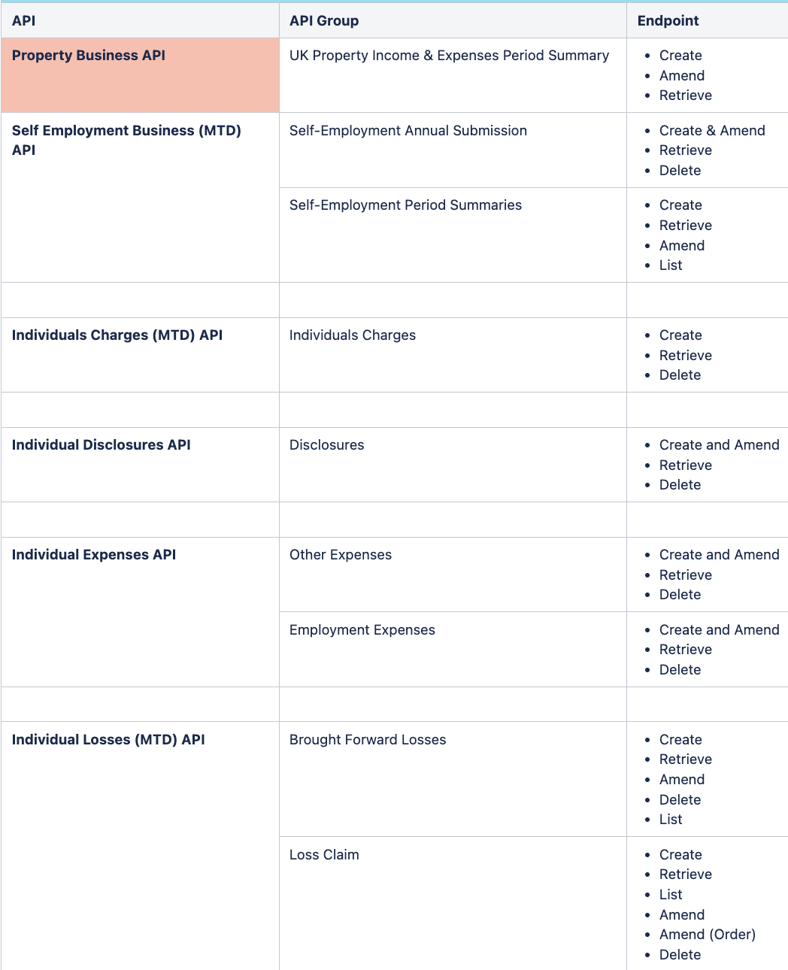
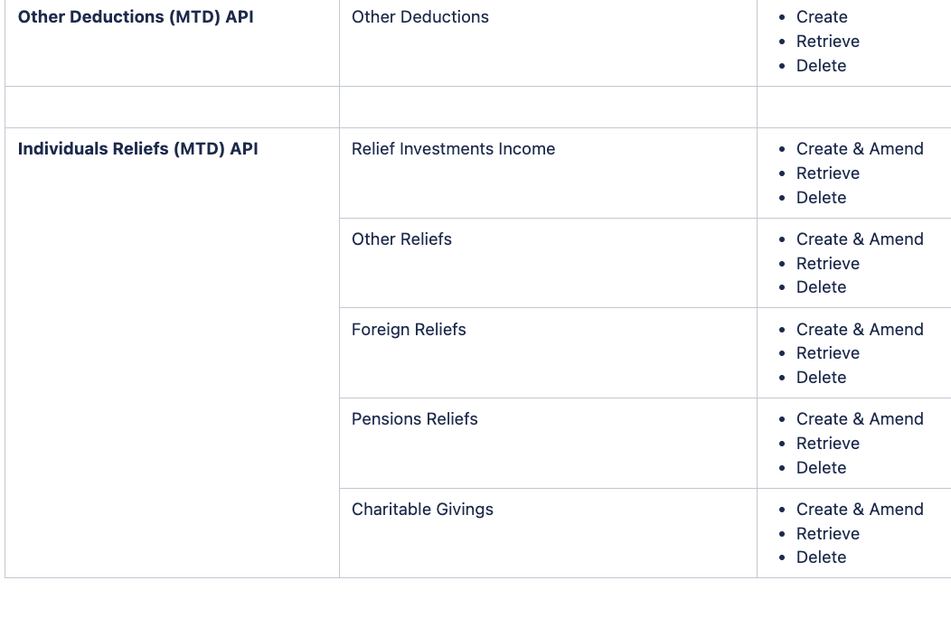
Release 2…Stateful

Slide 11
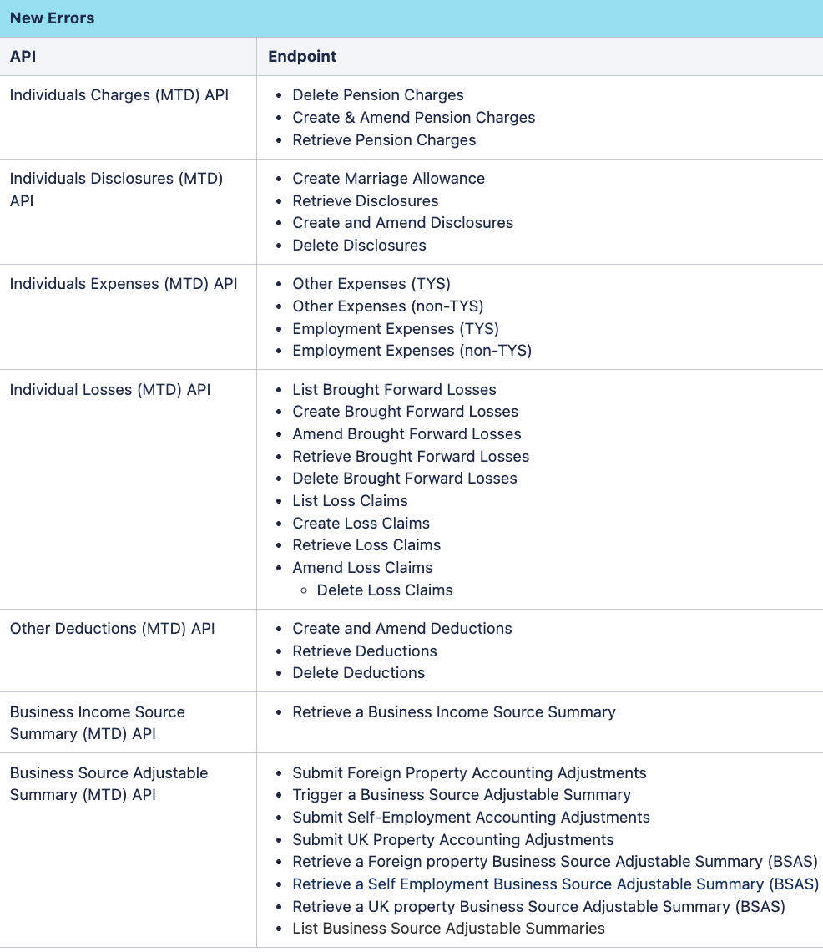
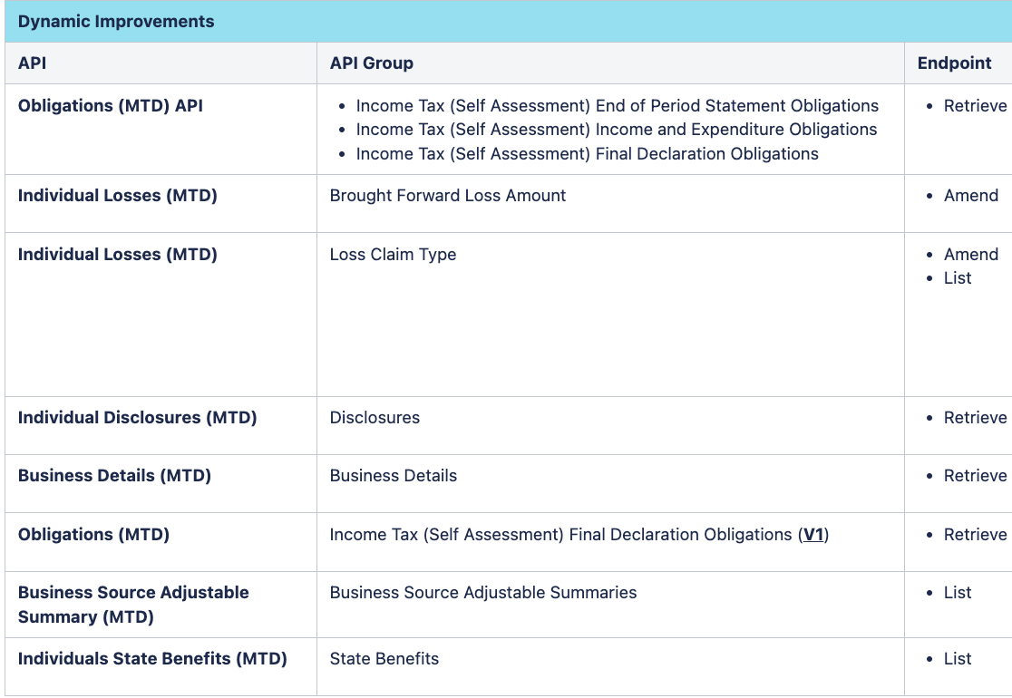
Release 2…

Slide 12
What Next
Expect to extend the Test API use cases
More stateful implementations
More Dynamic Implementations

Slide 13
Thank-you

